Slide 1
Chapter 3: Introduction to SQL

Slide 2
Chapter 3: Introduction to SQL
Overview of The SQL Query Language
SQL Data Definition
Basic Query Structure of SQL Queries
Queries on a Single Relation
Queries on Multiple Relations
The Natural Join
Additional Basic Operations
The Rename Operation
String Operations
Attribute Specification in Select Clause
Ordering the Display of Tuples
Where Clause Predicates
Notes:
1

Slide 3
Chapter 3: Introduction to SQL
Set Operations
The Union Operation
The Intersect Operation
The Except Operation
Null Values
Aggregate Functions
Basic Aggregation
Aggregation with Grouping
The Having Clause
Aggregation with Null and Boolean Values
Notes:
1

Slide 4
Chapter 3: Introduction to SQL
Nested Subqueries
Set Membership
Set Comparison
Test for Empty Relations
Test for the Absence of Duplicate Tuples
Subqueries in the From Clause
The with Clause
Scalar Subqueries
Modification of the Database
Deletion
Insertion
Updates
Notes:
1

Slide 5
History
IBM Sequel: language developed as part of System R project at the IBM San Jose Research Laboratory
Renamed Structured Query Language (SQL)
ANSI and ISO standard SQL:
SQL-86
SQL-89
SQL-92
SQL:1999 SQL:2003 SQL:2006 SQL:2008

Slide 6
3.1 Background of SQL
Parts of SQL
Data-definition language (DDL)
Data-manipulation language (DML)
Integrity
View definition
Transaction control
Embedded SQL and dynamic SQL
Authorization

Slide 7
3.2 SQL Data Definition
The SQL data-definition language (DDL) allows the specification of information about relations, including:
The schema for each relation.
The domain of values associated with each attribute.
Integrity constraints
And as we will see later, also other information such as
The set of indices to be maintained for each relations.
Security and authorization information for each relation.
The physical storage structure of each relation on disk.

Slide 8
3.2.1 Basic Domain Types
char(n): Fixed length character string, with user-specified length n.
varchar(n): Variable length, with user-specified maximum length n.
int: Integer (a finite subset of the integers that is machine-dependent).
smallint: Small integer (a machine-dependent)
numeric(p,d): Fixed point number, with user-specified precision of p digits, with d digits to the right of decimal point.
real, double precision: Floating point and double-precision floating point numbers, with machine-dependent precision.
float(n): Floating point number, with user-specified precision of at least n digits.
not null:
Null values are allowed in all the domain types.
Declaring an attribute to be not null prohibits null values for that attribute.
create domain person-name char(20) not null

Slide 9
3.2.2 Basic Schema Definition
An SQL relation is defined using the create table command:
create table r (A₁ D₁, A₂ D₂, ..., A_{n} D_{n}, (integrity-constraint₁), ..., (integrity-constraint_{k}))
r is the name of the relation
each A_{i} is an attribute name in the schema of relation r
D_{i} is the data type of values in the domain of attribute A_{i}
Example:
create table instructor ( ID char(5), name varchar(20), dept_name varchar(20), salary numeric(8,2))

Slide 10
Integrity Constraints in Create Table
primary key (A₁, ..., A_{n} )
foreign key (A_{m}, ..., A_{n} ) references r
not null
Example: Declare the primary key
create table instructor ( ID char(5), name varchar(20) not null, dept_name varchar(20), salary numeric(8,2), primary key (ID), foreign key (dept_name) references department);
primary key declaration on an attribute automatically ensures not null

Slide 11
And a Few More Relation Definitions
create table student ( ID varchar(5), name varchar(20) not null, dept_name varchar(20), tot_cred numeric(3,0), primary key (ID),
foreign key (dept_name) references department);
create table takes ( ID varchar(5), course_id varchar(8), sec_id varchar(8), semester varchar(6), year numeric(4,0), grade varchar(2),
primary key (ID, course_id, sec_id, semester, year) ,
foreign key (ID) references student, foreign key (course_id, sec_id, semester, year) references section);
Note: sec_id can be dropped from primary key above, to ensure a student cannot be registered for two sections of the same course in the same semester

Slide 12
Updates to tables
Insert （3.9.2）
insert into instructor values (‘10211’, ’Smith’, ’Biology’, 66000);
Delete
delete from student
Drop Table
drop table r
Alter
alter table r add A D
where A is the name of the attribute to be added to relation r and D is the domain of A.
All tuples in the relation are assigned null as the value for the new attribute.
alter table r drop A
where A is the name of an attribute of relation r
Dropping of attributes not supported by many databases.

Slide 13
3.3 Basic Structure of SQL Queries
A typical SQL query has the form: select A₁, A₂, ..., A_{n} from r₁, r₂, ..., r_{m} where P
A_{i} represents an attribute
R_{i} represents a relation
P is a predicate.
The result of an SQL query is a relation.
Notes:
2

Slide 14
3.3.1 Queries on a Single Relation
The select clause list the attributes desired in the result of a query
corresponds to the projection operation of the relational algebra
Example: find the names of all instructors: select name from instructor
NOTE: SQL names are case insensitive (i.e., you may use upper- or lower-case letters.)
E.g., Name ≡ NAME ≡ name
Some people use upper case wherever we use bold font.
Notes:
3

Slide 15
The select Clause (Cont.)
SQL allows duplicates in relations as well as in query results.
To force the elimination of duplicates, insert the keyword distinct（不同的，独特的） after select.
Find the department names of all instructors, and remove duplicates
select distinct dept_name from instructor
The keyword all specifies that duplicates not be removed.
select all dept_name from instructor
Notes:
4

Slide 16
The select Clause (Cont.)
An asterisk in the select clause denotes “all attributes”
select * from instructor
The select clause can contain arithmetic expressions involving the operation, +, –, ∗, and /, and operating on constants or attributes of tuples.
The query:
select ID, name, salary/12 from instructor
would return a relation that is the same as the instructor relation, except that the value of the attribute salary is divided by 12.
Notes:
5

Slide 17
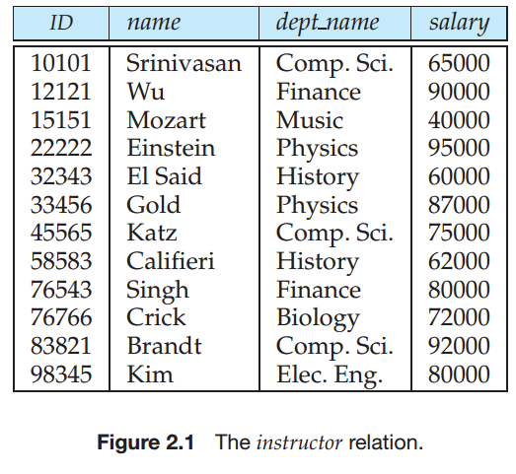
The where Clause
The where clause specifies conditions that the result must satisfy
Corresponds to the selection predicate of the relational algebra.
To find all instructors in Comp. Sci. dept with salary > 80000
Notes:
6

Slide 18
The where Clause
The where clause specifies conditions that the result must satisfy
Corresponds to the selection predicate of the relational algebra.
To find all instructors in Comp. Sci. dept with salary > 80000
select name from instructor where dept_name = ‘Comp. Sci.' and salary > 80000
Comparison results can be combined using the logical connectives and, or, and not.
Comparisons can be applied to results of arithmetic expressions.
Notes:
6

Slide 19
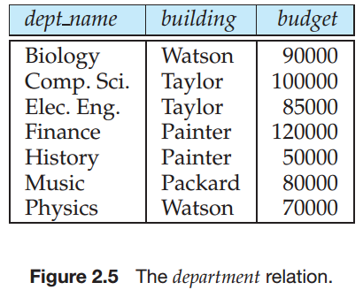
3.3.2 Queries on Multiple Relations
“Retrieve the names of all instructors, along with their department names and department building name.”

Slide 20
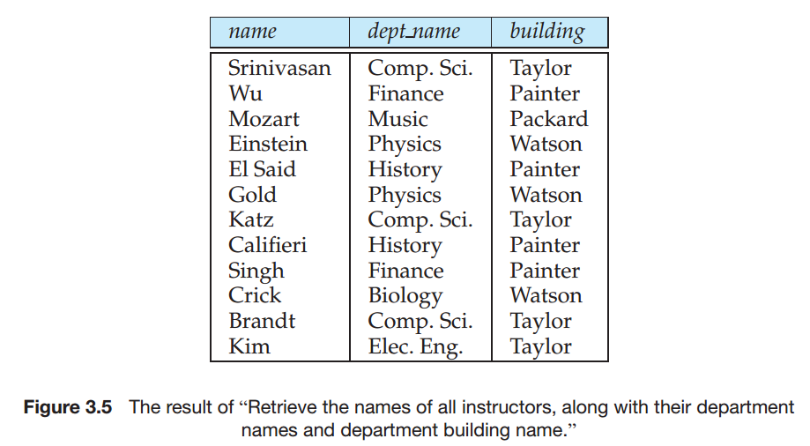
3.3.2 Queries on Multiple Relations

Slide 21

3.3.2 Queries on Multiple Relations

Slide 22
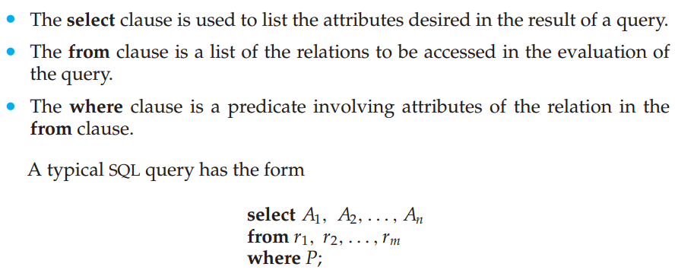
As we have seen earlier, an SQL query can contain three types of clauses, the select clause, the from clause, and the where clause. The role of each clause is as follows:

Slide 23
The from Clause
The from clause lists the relations involved in the query
Corresponds to the Cartesian product operation of the relational algebra.
Find the Cartesian product instructor X teaches
select ∗ from instructor, teaches
generates every possible instructor – teaches pair, with all attributes from both relations.
Cartesian product not very useful directly, but useful combined with where-clause condition (selection operation in relational algebra).
Notes:
8

Slide 24
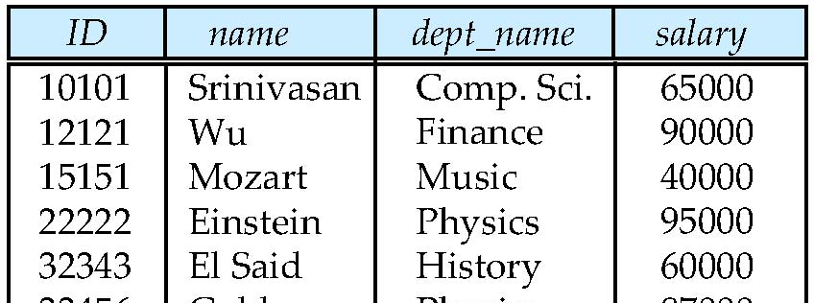
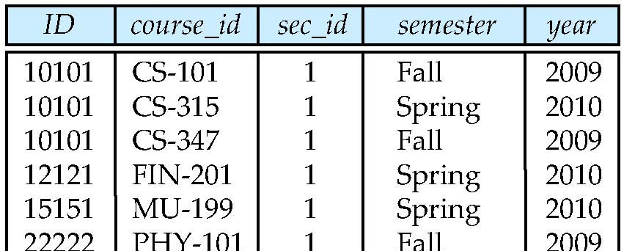
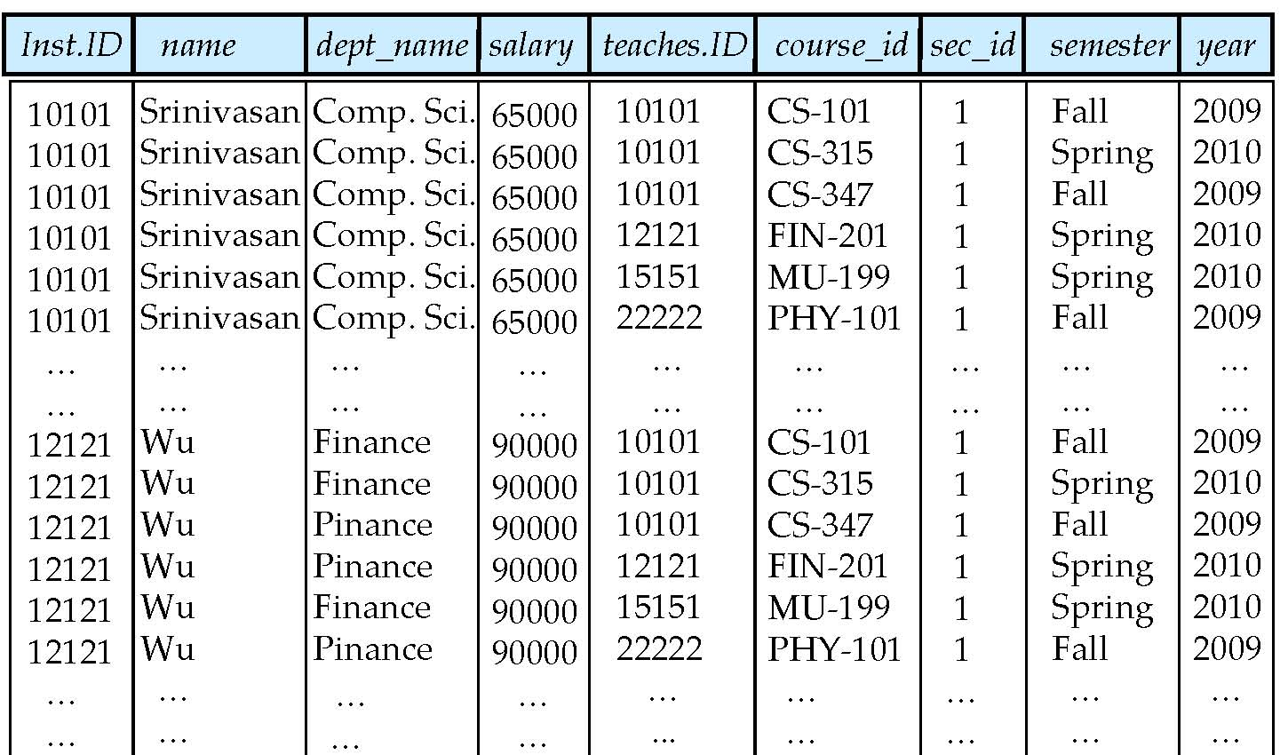
Cartesian Product
instructor
teaches

Slide 25
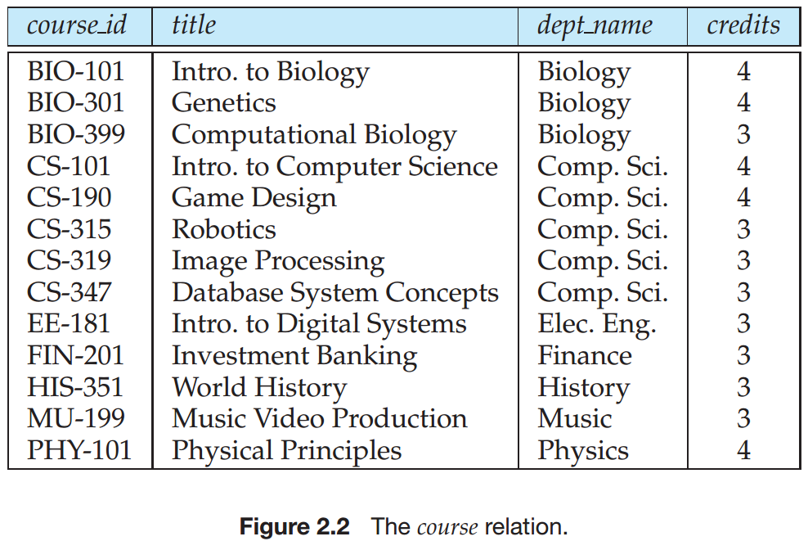
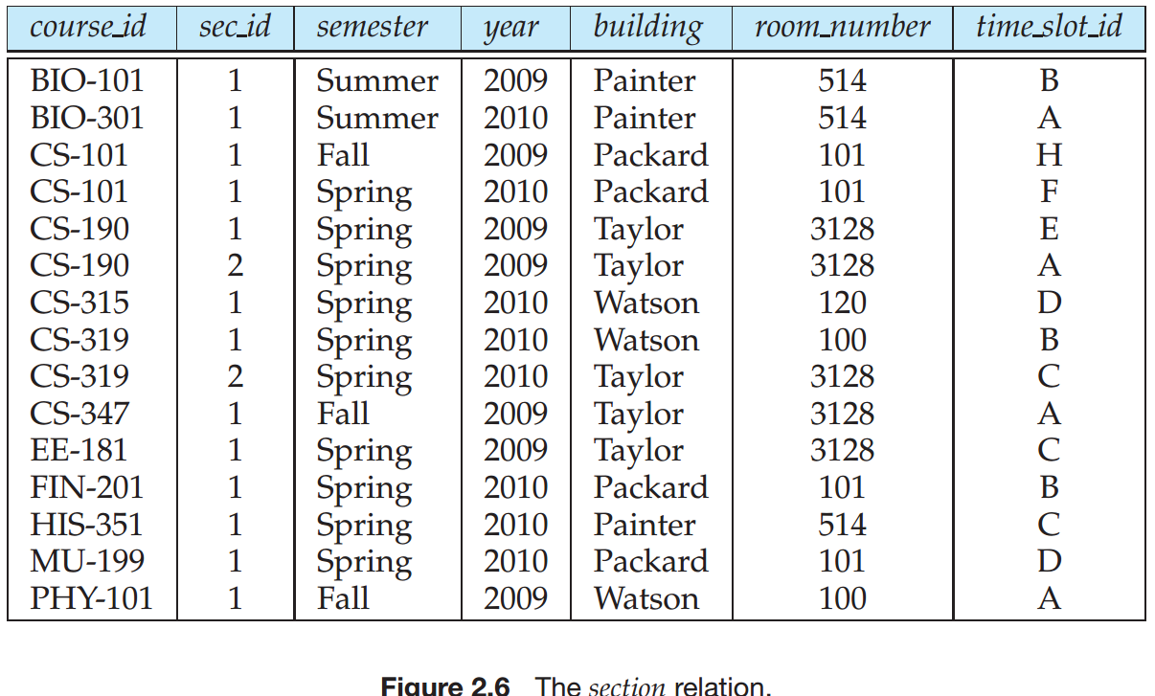
Joins
For all instructors who have taught courses, find their names and the course ID of the courses they taught.
Find the course ID, semester, year and title of each course offered by the Comp. Sci. department
instructor
teaches

Slide 26
Joins
For all instructors who have taught courses, find their names and the course ID of the courses they taught.
select name, course_id from instructor, teaches where instructor.ID = teaches.ID
Find the course ID, semester, year and title of each course offered by the Comp. Sci. department

Slide 27
Joins
For all instructors who have taught courses, find their names and the course ID of the courses they taught.
select name, course_id from instructor, teaches where instructor.ID = teaches.ID
Find the course ID, semester, year and title of each course offered by the Comp. Sci. department
select section.course_id, semester, year, title from section, course where section.course_id = course.course_id and dept_name = ‘Comp. Sci.'

Slide 28
3.3.3 The Natural Join
Natural join matches tuples with the same values for all common attributes, and retains only one copy of each common column
select * from instructor natural join teaches;

Slide 29
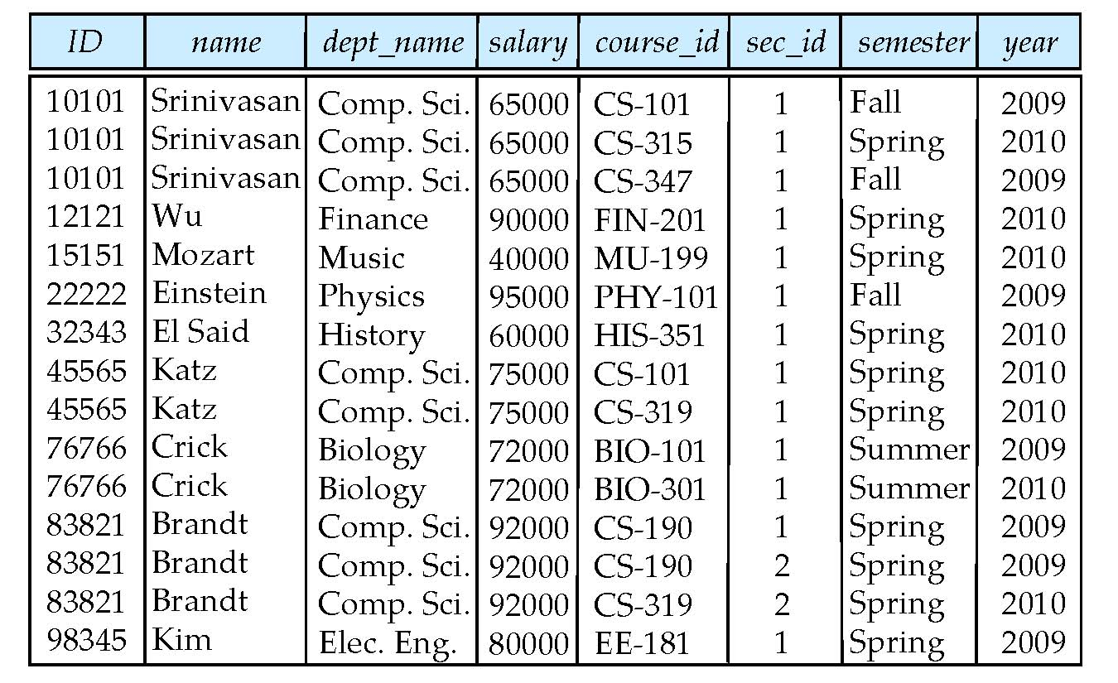

Slide 30
Natural Join Example
List the names of instructors along with the course ID of the courses that they taught.
instructor
teaches

Slide 31
Natural Join Example
List the names of instructors along with the course ID of the courses that they taught.
select name, course_id from instructor, teaches where instructor.ID = teaches.ID;
select name, course_id from instructor natural join teaches;

Slide 32
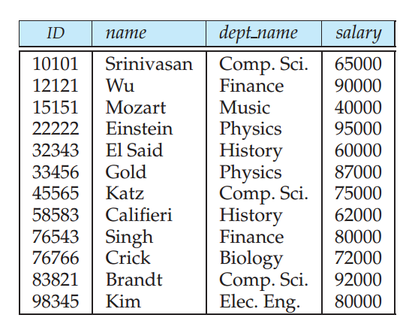
3.4.1 The Rename Operation
The SQL allows renaming relations and attributes using the as clause:
old-name as new-name
E.g.,
select ID, name, salary/12 as monthly_salary from instructor
Find the names of all instructors who have a higher salary than some instructor in ‘Comp. Sci’.
Notes:
9

Slide 33
3.4.1 The Rename Operation
The SQL allows renaming relations and attributes using the as clause:
old-name as new-name
E.g.,
select ID, name, salary/12 as monthly_salary from instructor
Find the names of all instructors who have a higher salary than some instructor in ‘Comp. Sci’.
select distinct T. name from instructor as T, instructor as S where T.salary > S.salary and S.dept_name = ‘Comp. Sci.’
Keyword as is optional and may be omitted instructor as T ≡ instructor T
Notes:
9

Slide 34
3.4.2 String Operations
SQL includes a string-matching operator for comparisons on character strings. The operator like uses patterns that are described using two special characters:
percent (%). The % character matches any substring.
underscore (_). The _ character matches any character.
Find the names of all instructors whose name includes the substring “dar”.
select name from instructor where name like '%dar%'
Match the string “100%”
like ‘100 \%' escape '\'
in that above we use backslash (\) as the escape character.

Slide 35
String Operations (Cont.)
Patters are case sensitive.
Pattern matching examples:
‘Intro%’ matches any string beginning with “Intro”.
‘%Comp’ matches any string containing “Comp” as a substring.
‘_ _ _’ matches any string of exactly three characters.
‘_ _ _ %’ matches any string of at least three characters.
SQL supports a variety of string operations such as
concatenation (using “||”)
converting from upper to lower case (and vice versa)

Slide 36
3.4.3 Attribute Specification in Select Clause
The asterisk symbol “ * ” can be used in the select clause to denote “all attributes.”
Thus, the use of instructor.* in the select clause of the query:
select instructor.* from instructor, teaches where instructor.ID= teaches.ID;
indicates that all attributes of instructor are to be selected.

Slide 37
3.4.4 Ordering the Display of Tuples
List in alphabetic order the names of all instructors
select distinct name from instructor order by name
We may specify desc for descending order or asc for ascending order, for each attribute; ascending order is the default.
Example: order by name desc
Can sort on multiple attributes
Example: order by dept_name, name

Slide 38
3.4.5 Where Clause Predicates
SQL includes a between comparison operator
Example: Find the names of all instructors with salary between $90,000 and $100,000 (that is, ≥ $90,000 and ≤ $100,000)
select name from instructor where salary between 90000 and 100000
Tuple comparison
select name, course_id from instructor, teaches where (instructor.ID, dept_name) = (teaches.ID, ’Biology’);
Notes:
7

Slide 39
3.5 Set Operations
Set operations union, intersect, and except
Each of the above operations automatically eliminates duplicates
To retain all duplicates use the corresponding multiset versions union all, intersect all and except all.

Slide 40
3.5 Set Operations
Find courses that ran in Fall 2009 or in Spring 2010
Find courses that ran in Fall 2009 and in Spring 2010
Find courses that ran in Fall 2009 but not in Spring 2010

Slide 41
3.5 Set Operations
Find courses that ran in Fall 2009 or in Spring 2010
(select course_id from section where sem = ‘Fall’ and year = 2009) union (select course_id from section where sem = ‘Spring’ and year = 2010)
Find courses that ran in Fall 2009 and in Spring 2010
Find courses that ran in Fall 2009 but not in Spring 2010

Slide 42
3.5 Set Operations
Find courses that ran in Fall 2009 or in Spring 2010
(select course_id from section where sem = ‘Fall’ and year = 2009) union (select course_id from section where sem = ‘Spring’ and year = 2010)
Find courses that ran in Fall 2009 and in Spring 2010
(select course_id from section where sem = ‘Fall’ and year = 2009) intersect (select course_id from section where sem = ‘Spring’ and year = 2010)
Find courses that ran in Fall 2009 but not in Spring 2010
(select course_id from section where sem = ‘Fall’ and year = 2009) except (select course_id from section where sem = ‘Spring’ and year = 2010)

Slide 43
3.6 Null Values
It is possible for tuples to have a null value, denoted by null, for some of their attributes
null signifies an unknown value or that a value does not exist.
The result of any arithmetic expression involving null is null
Example: 5 + null returns null
The predicate is null can be used to check for null values.
Example: Find all instructors whose salary is null.
select name from instructor where salary is null

Slide 44
Null Values and Three Valued Logic
Any comparison with null returns unknown
Example: 5 < null or null <> null or null = null
Three-valued logic using the truth value unknown:
OR: (unknown or true) = true, (unknown or false) = unknown (unknown or unknown) = unknown
AND: (true and unknown) = unknown, (false and unknown) = false, (unknown and unknown) = unknown
NOT: (not unknown) = unknown
“P is unknown” evaluates to true if predicate P evaluates to unknown
Result of where clause predicate is treated as false if it evaluates to unknown

Slide 45
3.7 Aggregate Functions
These functions operate on the multiset of values of a column of a relation, and return a value
avg: average value min: minimum value max: maximum value sum: sum of values count: number of values

Slide 46
3.7.1 Basic Aggregation
Find the average salary of instructors in the Computer Science department
select avg (salary) from instructor where dept_name= ’Comp. Sci.’;
Find the total number of instructors who teach a course in the Spring 2010 semester
Find the number of tuples in the course relation

Slide 47
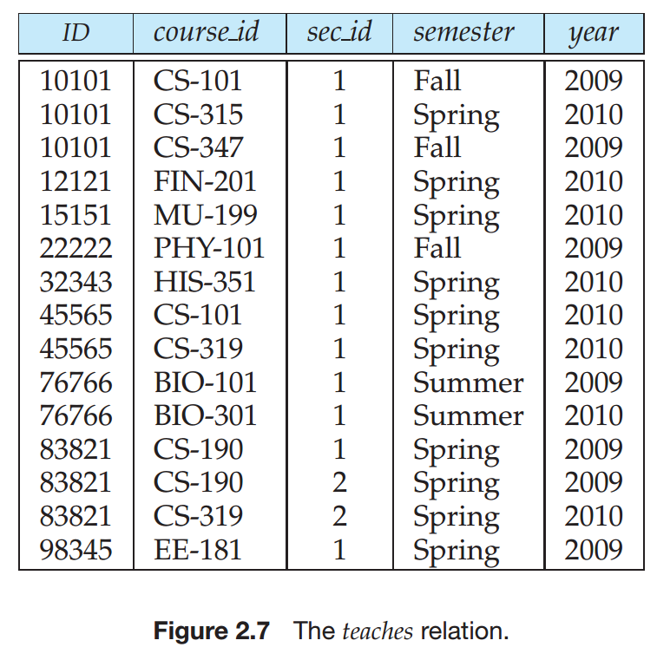
3.7.1 Basic Aggregation
Find the average salary of instructors in the Computer Science department
select avg (salary) from instructor where dept_name= ’Comp. Sci.’;
Find the total number of instructors who teach a course in the Spring 2010 semester
select count (distinct ID) from teaches where semester = ’Spring’ and year = 2010;
Find the number of tuples in the course relation

Slide 48
3.7.1 Basic Aggregation
Find the average salary of instructors in the Computer Science department
select avg (salary) from instructor where dept_name= ’Comp. Sci.’;
Find the total number of instructors who teach a course in the Spring 2010 semester
select count (distinct ID) from teaches where semester = ’Spring’ and year = 2010;
Find the number of tuples in the course relation
select count (*) from course;

Slide 49
3.7.2 Aggregation with Grouping– Group By
Find the average salary of instructors in each department

Slide 50
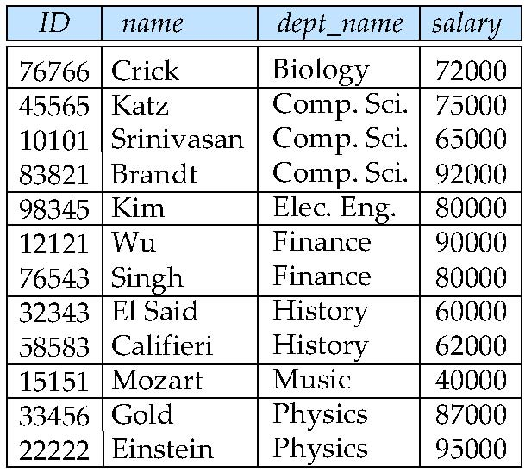
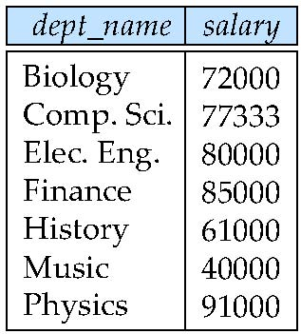
3.7.2 Aggregation with Grouping– Group By
Find the average salary of instructors in each department
select dept_name, avg (salary) as avg_salary from instructor group by dept_name;
avg_salary

Slide 51
Aggregation (Cont.)
Attributes in select clause outside of aggregate functions must appear in group by list
/* erroneous query */ select dept_name, ID, avg (salary) from instructor group by dept_name;

Slide 52
3.7.3 The Having Clause
Find the names and average salaries of all departments whose average salary is greater than 42000
Note: predicates in the having clause are applied after the formation of groups whereas predicates in the where clause are applied before forming groups

Slide 53
3.7.3 The Having Clause
Find the names and average salaries of all departments whose average salary is greater than 42000
select dept_name, avg (salary)
from instructor
group by dept_name
having avg (salary) > 42000;
Note: predicates in the having clause are applied after the formation of groups whereas predicates in the where clause are applied before forming groups

Slide 54
1. As was the case for queries without aggregation, the from clause is first evaluated to get a relation.
2. If a where clause is present, the predicate in the where clause is applied on the result relation of the from clause.
3. Tuples satisfying the where predicate are then placed into groups by the group by clause if it is present. If the group by clause is absent, the entire set of tuples satisfying the where predicate is treated as being in one group.
4. The having clause, if it is present, is applied to each group; the groups that do not satisfy the having clause predicate are removed.
5. The select clause uses the remaining groups to generate tuples of the result of the query, applying the aggregate functions to get a single result tuple for each group.

Slide 55
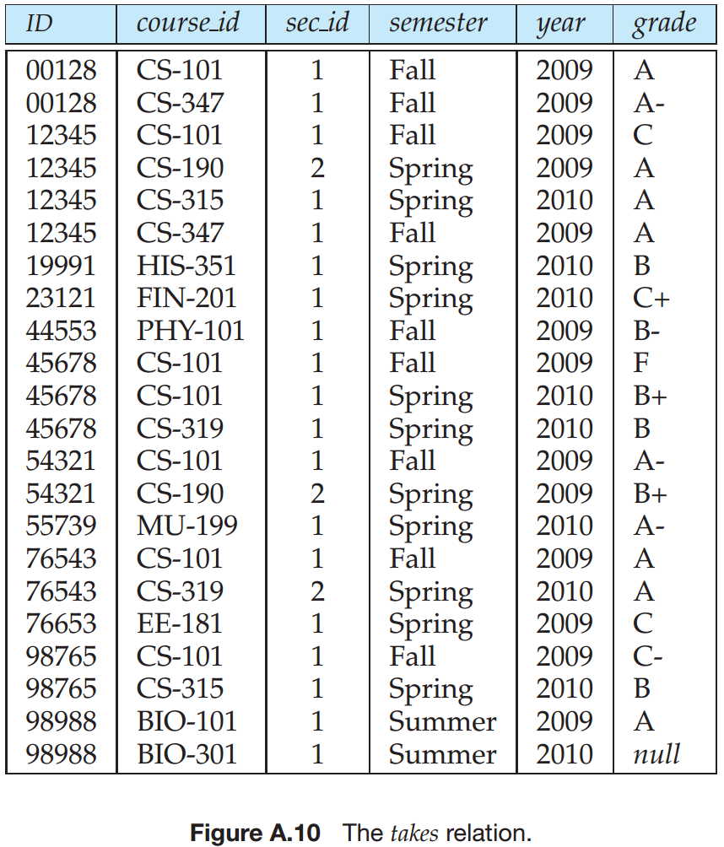
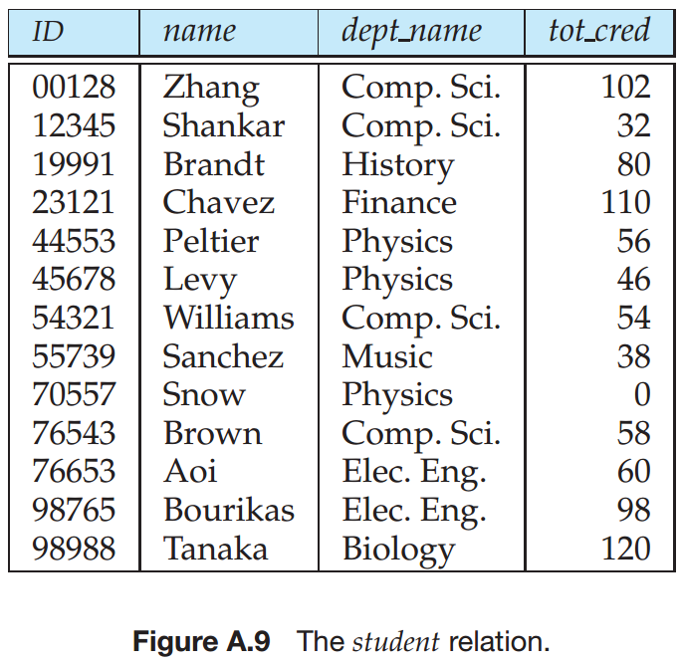
having clause and a where clause
For each course section offered in 2009, find the average total credits (tot cred) of all students enrolled in the section, if the section had at least 2 students.

Slide 56
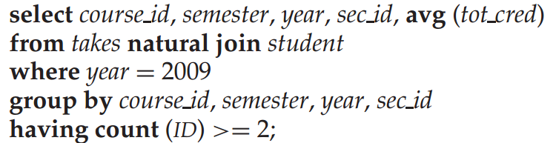
having clause and a where clause
For each course section offered in 2009, find the average total credits (tot cred) of all students enrolled in the section, if the section had at least 2 students.

Slide 57
3.7.4 Aggregation with Null and Boolean Values
Total all salaries
select sum (salary ) from instructor
Above statement ignores（忽略） null amounts
Result is null if there is no non-null amount
All aggregate operations except count(*) ignore tuples with null values on the aggregated attributes
What if collection has only null values?
count returns 0
all other aggregates return null

Slide 58
3.8 Nested Subqueries
SQL provides a mechanism for the nesting of subqueries.
A subquery is a select-from-where expression that is nested within another query.
A common use of subqueries is to perform tests for set membership, set comparisons, and set cardinality.

Slide 59
3.8.1 Set Membership
Find courses offered in Fall 2009 and in Spring 2010
Find courses offered in Fall 2009 but not in Spring 2010

Slide 60
3.8.1 Set Membership
Find courses offered in Fall 2009 and in Spring 2010
select distinct course_id
from section
where semester = ’Fall’ and year= 2009 and course_id in (select course_id
from section
where semester = ’Spring’ and year= 2010);
Find courses offered in Fall 2009 but not in Spring 2010
select distinct course_id
from section
where semester = ’Fall’ and year= 2009 and course_id not in (select course_id
from section
where semester = ’Spring’ and year= 2010);

Slide 61
Example Query
Find the total number of (distinct) students who have taken course sections taught by the instructor with ID 10101（找出（不同的）学生总数，他们选修了ID为10101教师所讲授的课程段）

Slide 62
Example Query
Find the total number of (distinct) students who have taken course sections taught by the instructor with ID 10101（找出（不同的）学生总数，他们选修了ID为10101教师所讲授的课程段）
select count (distinct ID)
from takes
where (course_id, sec_id, semester, year) in (select course_id, sec_id, semester, year
from teaches
where teaches.ID= 10101);

Slide 63
3.8.2 Set Comparison
Find names of instructors with salary greater than that of some (at least one) instructor in the Biology department.（找出工资至少比生物系某一个教师工资高的教师姓名）

Slide 64
3.8.2 Set Comparison
Find names of instructors with salary greater than that of some (at least one) instructor in the Biology department.（找出工资至少比生物系某一个教师工资高的教师姓名）
select distinct T.name
from instructor as T, instructor as S
where T.salary > S.salary and S.dept name = ’Biology’;
Same query using > some clause
select name
from instructor
where salary > some (select salary
from instructor
where dept name = ’Biology’);

Slide 65
Definition of Some Clause
F <comp> some r ⇔ ∃ t ∈ r such that (F <comp> t ) Where <comp> can be: <, ≤, >, =, <>
0
(5 < some
5
) = true
(read: 5 < some tuple in the relation)
6
0
(5 < some
5
) = false
0
(5 = some
) = true
5
0
(5 ≠ some
5
) =

Slide 66
Definition of Some Clause
F <comp> some r ⇔ ∃ t ∈ r such that (F <comp> t ) Where <comp> can be: <, ≤, >, =, ≠
0
(5 < some
5
) = true
(read: 5 < some tuple in the relation)
6
0
(5 < some
5
) = false
0
(5 = some
) = true
5
0
(5 ≠ some
5
) = true (since 0 ≠ 5)
(= some) ≡ in
However, (≠ some) ≡ not in

Slide 67
Definition of all Clause
F <comp> all r ⇔ ∀ t ∈ r (F <comp> t)
0
(5 < all
5
) = false
6
6
(5 < all
) = true
10
4
(5 = all
) = false
5
4
(5 <> all
) = true (since 5 ≠ 4 and 5 ≠ 6)
6
(<>all) ≡ not in
However, (= all) ≡ in

Slide 68
Example Query
Find the names of all instructors whose salary is greater than the salary of all instructors in the Biology department.

Slide 69
Example Query
Find the names of all instructors whose salary is greater than the salary of all instructors in the Biology department.
select name
from instructor
where salary > all (select salary
from instructor
where dept name = ’Biology’);

Slide 70
3.8.3 Test for Empty Relations
The exists construct returns the value true if the argument subquery is nonempty.
exists r ⇔ r ≠ Ø
not exists r ⇔ r = Ø

Slide 71
Correlation Variables
Yet another way of specifying the query “Find all courses taught in both the Fall 2009 semester and in the Spring 2010 semester”
select course_id from section as S where semester = ’Fall’ and year = 2009 and exists (select * from section as T where semester = ’Spring’ and year= 2010 and S.course_id = T.course_id);
Correlated subquery(相关子查询)

Slide 72
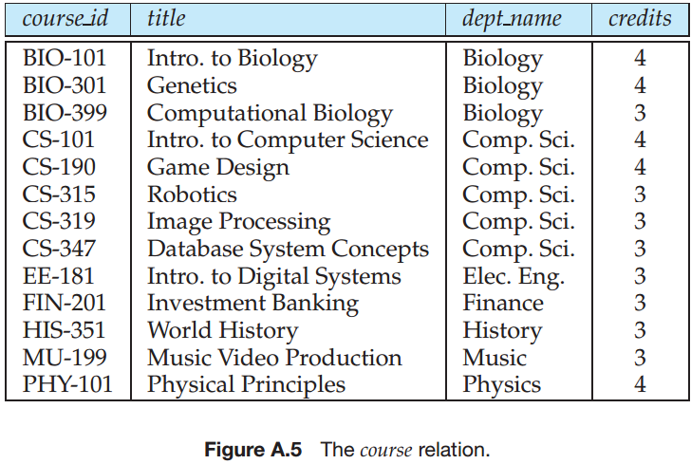
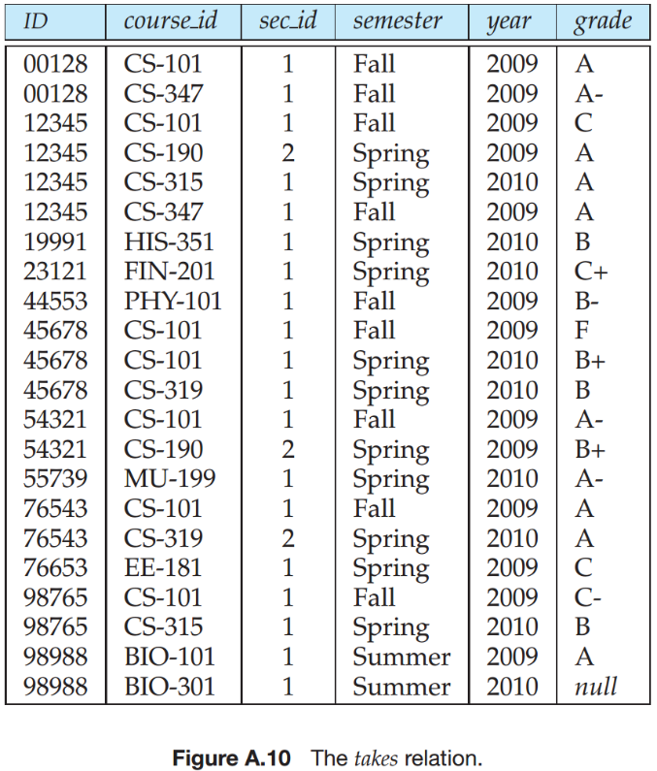
Not Exists
Find all students who have taken all courses offered in the Biology department.

Slide 73
Not Exists
Find all students who have taken all courses offered in the Biology department.
select distinct S.ID, S.name
from student as S
where not exists ( (select course_id
from course
where dept_name = ’Biology’)
except
(select T.course_id
from takes as T
where S.ID = T.ID));
First nested query lists all courses offered in Biology
Second nested query lists all courses a particular student took
Note that X – Y = Ø ⇔ X ⊆ Y

Slide 74
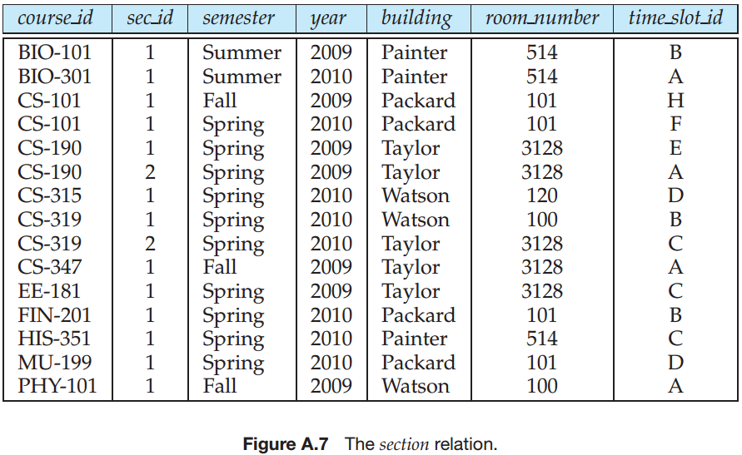
3.8.4 Test for the Absence of Duplicate Tuples
The unique construct tests whether a subquery has any duplicate tuples in its result.
The unique construct evaluates to “true” on an empty set.
Find all courses that were offered at most once in 2009
select T.course_id from course as T where unique (select R.course_id from section as R where T.course_id= R.course_id and R.year = 2009);

Slide 75
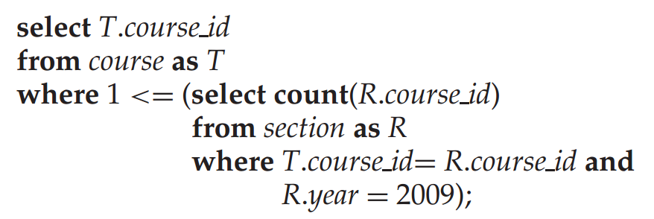
3.8.4 Test for the Absence of Duplicate Tuples
The unique construct tests whether a subquery has any duplicate tuples in its result.
The unique construct evaluates to “true” on an empty set.
Find all courses that were offered at most once in 2009
select T.course_id from course as T where unique (select R.course_id from section as R where T.course_id= R.course_id and R.year = 2009);

Slide 76
3.8.5 Subqueries in the From Clause
SQL allows a subquery expression to be used in the from clause
Find the average instructors’ salaries of those departments where the average salary is greater than $42,000.”
Note that we do not need to use the having clause
Another way to write above query

Slide 77
3.8.5 Subqueries in the From Clause
SQL allows a subquery expression to be used in the from clause
Find the average instructors’ salaries of those departments where the average salary is greater than $42,000.”
select dept_name, avg_salary from (select dept_name, avg (salary) as avg_salary from instructor group by dept_name) where avg_salary > 42000;
Note that we do not need to use the having clause
Another way to write above query

Slide 78
3.8.5 Subqueries in the From Clause
SQL allows a subquery expression to be used in the from clause
Find the average instructors’ salaries of those departments where the average salary is greater than $42,000.”
select dept_name, avg_salary from (select dept_name, avg (salary) as avg_salary from instructor group by dept_name) where avg_salary > 42000;
Note that we do not need to use the having clause
Another way to write above query
select dept_name, avg_salary from (select dept_name, avg (salary) from instructor group by dept_name) as dept_avg (dept_name, avg_salary)
where avg_salary > 42000;

Slide 79
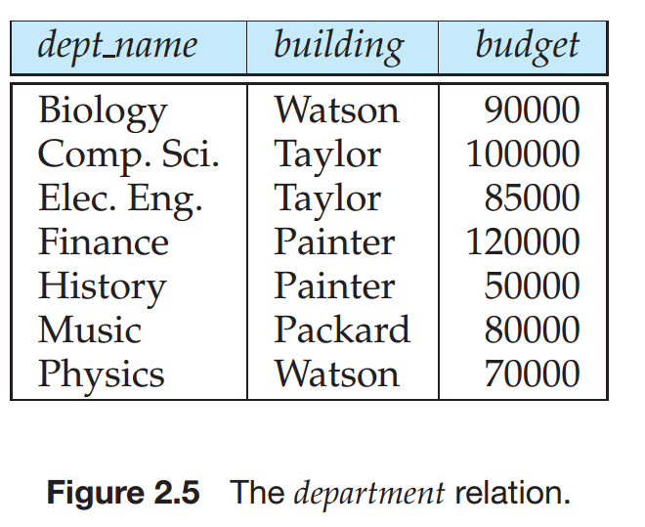
3.8.6 The with Clause
The with clause provides a way of defining a temporary relation whose definition is available only to the query in which the with clause occurs.
Find all departments with the maximum budget

Slide 80
3.8.6 The with Clause
The with clause provides a way of defining a temporary relation whose definition is available only to the query in which the with clause occurs.
Find all departments with the maximum budget with max_budget (value) as (select max(budget) from department) select budget from department, max_budget where department.budget = max_budget.value;

Slide 81
Complex Queries using With Clause
Find all departments where the total salary is greater than the average of the total salary at all departments

Slide 82
Complex Queries using With Clause
Find all departments where the total salary is greater than the average of the total salary at all departments
with dept _total (dept_name, value) as
(select dept_name, sum(salary)
from instructor
group by dept_name),
dept_total_avg(value) as
(select avg(value)
from dept_total)
select dept_name
from dept_total, dept_total_avg
where dept_total.value >= dept_total_avg.value;

Slide 83
3.9 Modification of the Database
Deletion of tuples from a given relation.
Insertion of new tuples into a given relation
Updating of values in some tuples in a given relation

Slide 84
3.9.1 Deletion
Delete all instructors
delete from instructor
Delete all instructors from the Finance department delete from instructor where dept_name= ’Finance’;
Delete all tuples in the instructor relation for those instructors associated with a department located in the Watson building.
delete from instructor where dept name in (select dept name from department where building = ’Watson’);

Slide 85
Deletion (Cont.)
Delete all instructors whose salary is less than the average salary of instructors
delete from instructor
where salary < (select avg (salary) from instructor);
Problem: as we delete tuples from deposit, the average salary changes
Solution used in SQL:
1. First, compute avg salary and find all tuples to delete
2. Next, delete all tuples found above (without
recomputing avg or retesting the tuples)

Slide 86
3.9.2 Insertion
Add a new tuple to course
insert into course values (’CS-437’, ’Database Systems’, ’Comp. Sci.’, 4);
or equivalently
insert into course (course_id, title, dept_name, credits) values (’CS-437’, ’Database Systems’, ’Comp. Sci.’, 4);
Add a new tuple to student with tot_creds set to null
insert into student values (’3003’, ’Green’, ’Finance’, null);

Slide 87
Insertion (Cont.)
Add all instructors to the student relation with tot_creds set to 0
insert into student select ID, name, dept_name, 0 from instructor
The select from where statement is evaluated fully before any of its results are inserted into the relation.
Otherwise queries like
insert into table1 select * from table1
would cause problem

Slide 88
3.9.3 Updates
Increase salaries of instructors whose salary is over $100,000 by 3%, and all others receive a 5% raise
Write two update statements:
update instructor set salary = salary * 1.03 where salary > 100000; update instructor set salary = salary * 1.05 where salary <= 100000;
The order is important
Can be done better using the case statement (next slide)

Slide 89
Case Statement for Conditional Updates
Same query as before but with case statement
update instructor set salary = case when salary <= 100000 then salary * 1.05 else salary * 1.03 end

Slide 90
End of Chapter 3

